Slide 1

Rx Refill Status Usability Testing
December, 2022

Slide 2

About these slides
Resources for VA.gov Design Research | mm dd, yyyy
The next three slides are provided as a template for you to add to your research presentation.
Please copy them, and modify them to emphasize
Which moments or moments that matter from the Veteran journey to does the research applies to?
Which Digital Experience objectives the research supports.
A single slide, plain language list of the key findings from the research, no more than 7.
A single slide, plain language list of the secondary findings from the research, no more than 3.
A single slide, plain language list of the recommendations from the research, no more than 7.

Slide 3
Goals and Approach
Refill Status Changes | December, 2022
    Research Goals
    Determine if users respond positively to new tags, and how/if they interact with them.
    Identify major usability issues within updated Medication Details page.
    Determine Veteran’s understanding of 5 dates they are presented during their experience on My HealtheVet.
    Approach
    We conducted 11 in-person interviews using a high fidelity Adobe Xd prototype.

Slide 4
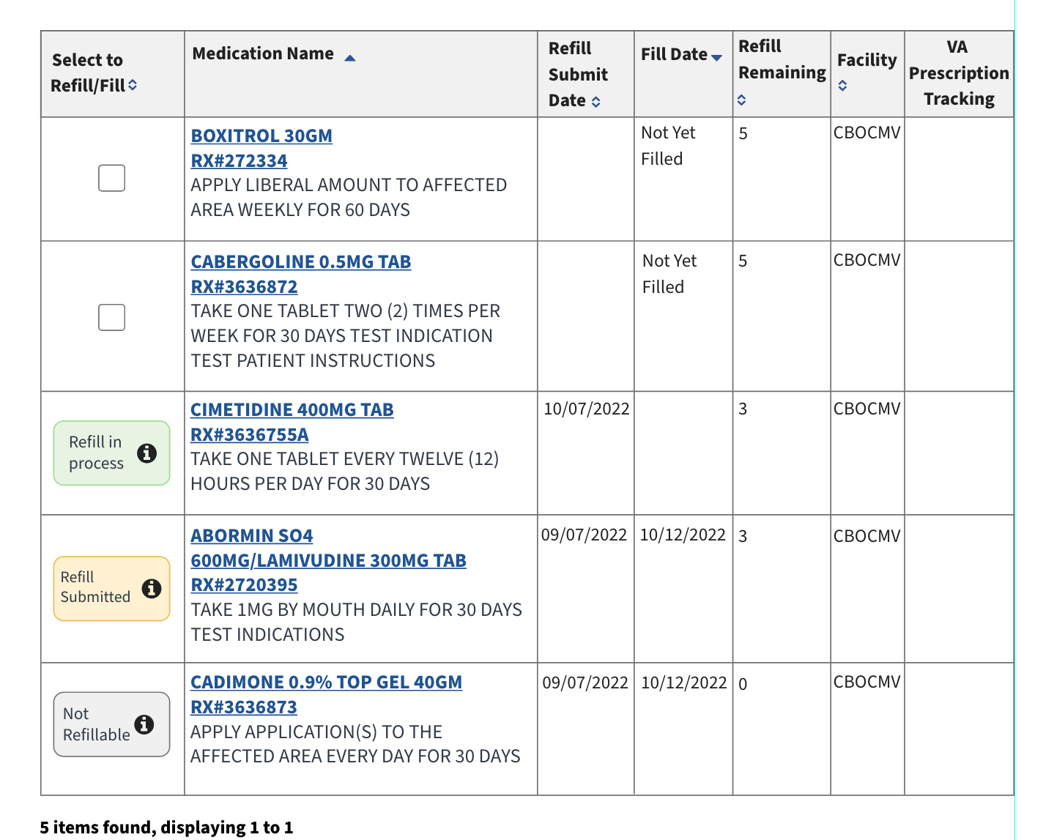
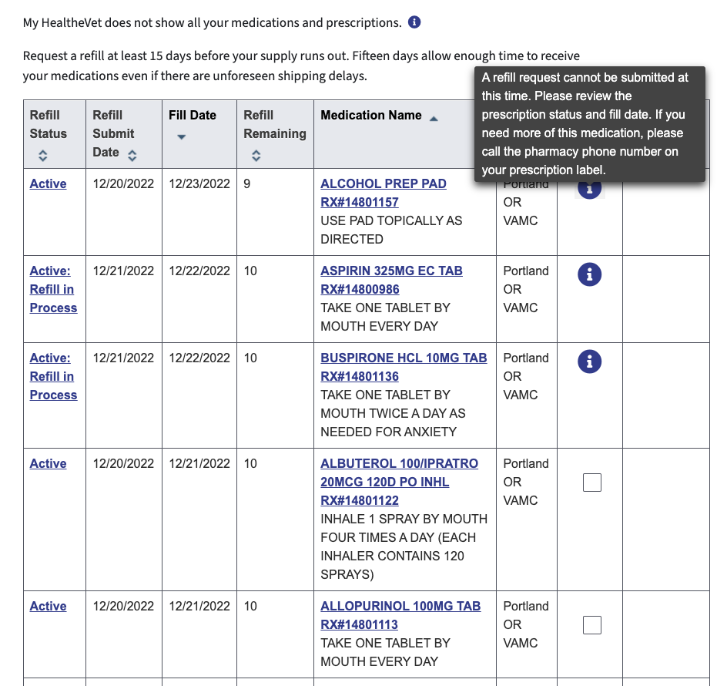
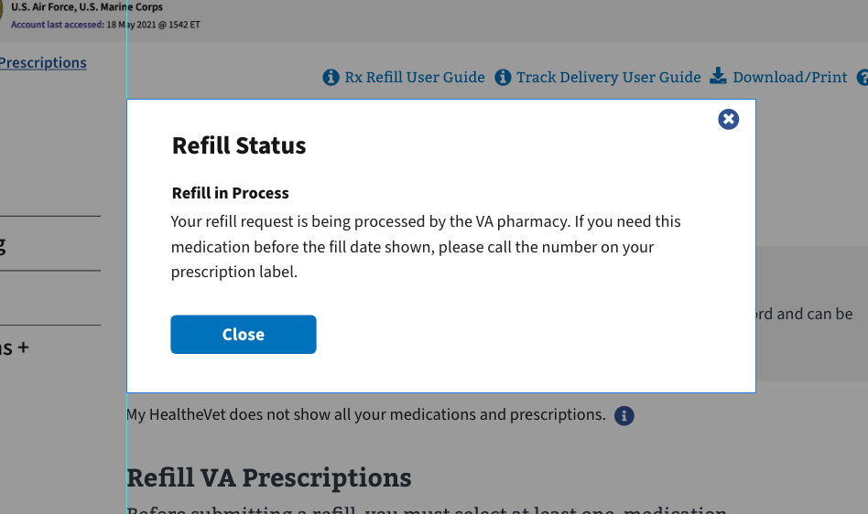
Background - Current designs
Refill Status Changes | December, 2022
Notes:
Medication Details page
Confusing design structure
“I didn’t know this existed before.”
Unexpected information
Current VA Prescription Refill page is unintuitive, confusing for users
Prescription status value unknown
Refill flow unclear
Obstructed information architecture – what’s important?
REMOVE THESE TEXT BOXES?

Slide 5
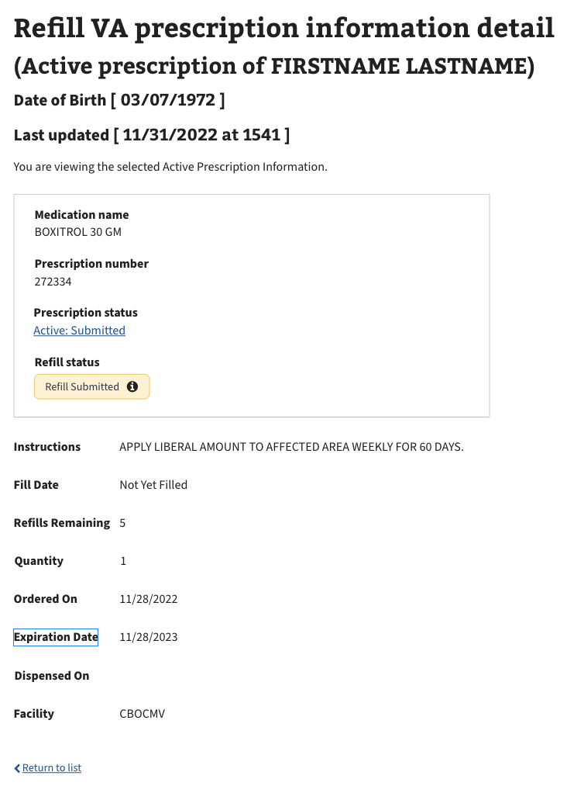
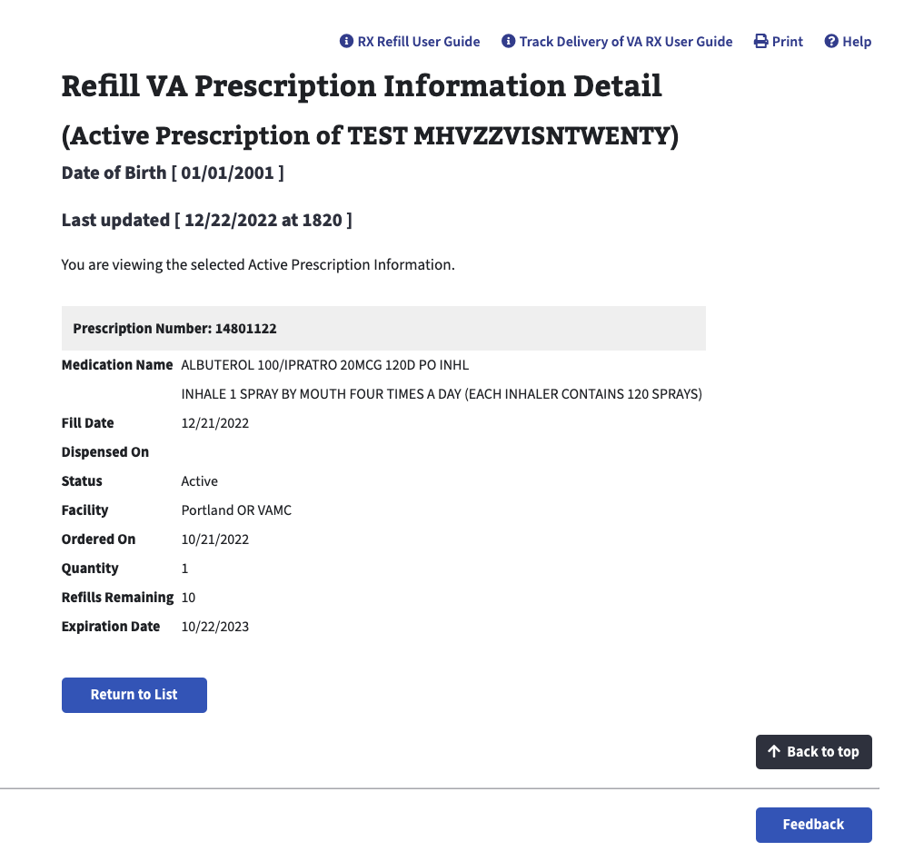
Background - Current designs
Refill Status Changes | December, 2022
Notes:
Medication Details page
Confusing design structure
“I didn’t know this existed before.”
Unexpected information
Current VA Prescription Refill page is unintuitive, confusing for users
Prescription status value unknown
Refill flow unclear
Obstructed information architecture – what’s important?
REMOVE THESE TEXT BOXES?

Slide 6
How this research maps to the Veteran journey
Refill Status Changes | December 2022
Taking care of myself
VA Health Care
Managing primary care
Empowering Veterans with personalized care
Taking care of my health
Reinventing myself
Joining
Serving
Getting out
Starting up
Taking care of myself
Retiring
Aging
Dying
Putting down roots
For a fully detailed Veteran journey, go to
https://github.com/department-of-veterans-affairs/va.gov-team/blob/master/platform/design/va-product-journey-maps/Veteran%20Journey%20Map.pdf
Serving and separation
Living civilian life
Retiring and aging

Slide 7
OCTO-DE goals that this research supports
Refill Status Changes | December, 2022
Not supported
Supported
Veterans and their families can apply for all benefits online
Veterans and their families can find a single, authoritative source of information
Veterans and their families trust the security, accuracy, and relevancy of VA.gov
Veterans can manage their health services online
VFS teams can build and deploy high-quality products for Veterans on the Platform
Logged-in users have a personalized experience, with relevant and time-saving features
Logged-in users can update their personal information easily and instantly
Logged-in users can easily track applications, claims, or appeals online
Completion rate of online transactions
Percent of applications submitted online (vs. paper)
Veteran satisfaction with VA.gov
Benefit use and enrollment, across all business lines
Benefit value (in $) delivered from online applications or transactions
Number of VA.gov users as a function of total Veteran population
Usage of digital, self-service tools
Measures
to
increase
Time to successful complete and submit online transactions
Time to process online applications (vs. paper)
Call center volume, wait time, and time to resolution
Time from online benefit discovery to benefit delivery
Measures
to
decrease

Slide 8
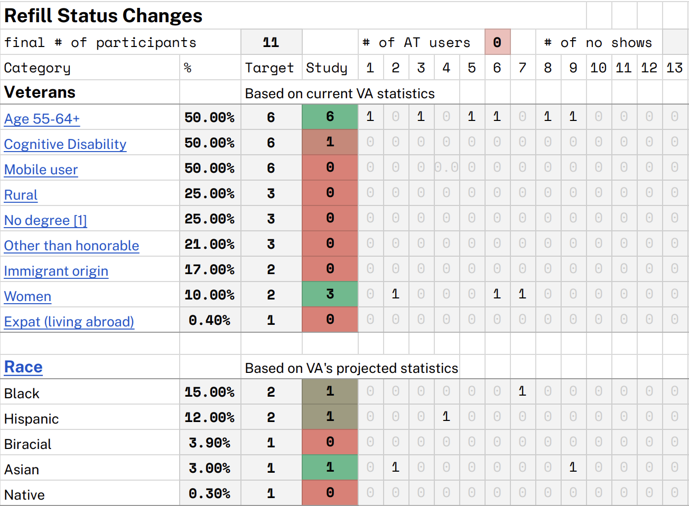
Participant Demographics
Refill Status Changes | December, 2022
Note: Veteran familiarity with MHV also recorded.
Findings may not include the perspectives of the following underserved Veteran groups:
Live in rural areas or abroad
Don’t have a degree
Identify as Latinx, Biracial, Asian, Native, or LGBTQ+)
We recommend studies with these underserved groups in the future.
Notes:
*Snowfall limited the number of participants we interviewed.

Slide 9
Research Questions & Hypothesis
Refill Status Changes | December, 2022
Filling a prescription
Do Veterans know how to refill prescriptions with the new tag design?
Do Veterans know they can interact with the tags? Is the pop-up design helpful?
Is the content in the tags helpful to Veterans?
Definitions and Glossary
How do Veterans react to the glossary? Using the glossary?
Are definitions, specifically new definitions like Active: Parked, easy for Veterans to understand?
Medication Details page
Do Veterans know what elements they can interact with when they have questions?
Are Veterans able to distinguish between a Refill status and Prescription status?
Defining Dates
Do Veterans understand the 5 different dates they may come across during their experience on the Prescription Refill page and the Medication Details page?

Slide 10
Research Questions & Hypothesis
Refill Status Changes | December, 2022
Hypothesis
The new color-coded tags will accurately inform Veterans of the Refill status of their prescriptions and indicate interactivity if Veterans have further questions regarding their refill status.
The glossary is confusing and needs to be updated with new content and visuals.
Having the Refill and Prescription statuses split on the Medication Details page will help Veterans stay informed about their prescriptions and refills.
  3.a. While it doesn’t have a tag, Veterans will know that the Prescription status hyperlink is interactive and.

Slide 11
New changes on Refill Page – tags, pop-ups
Refill Status Changes | December, 2022
VA Prescription Refill page adjustments
Changed table layout
Added colored tags of refill status
    Interacting with tags opens pop-up with definition, help
Prototype

Slide 12
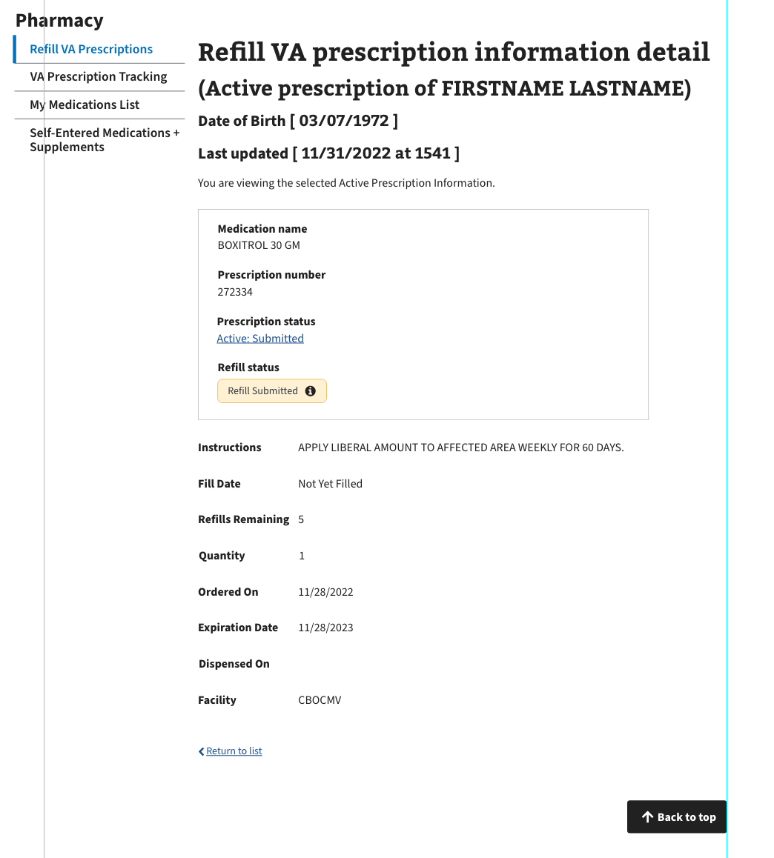
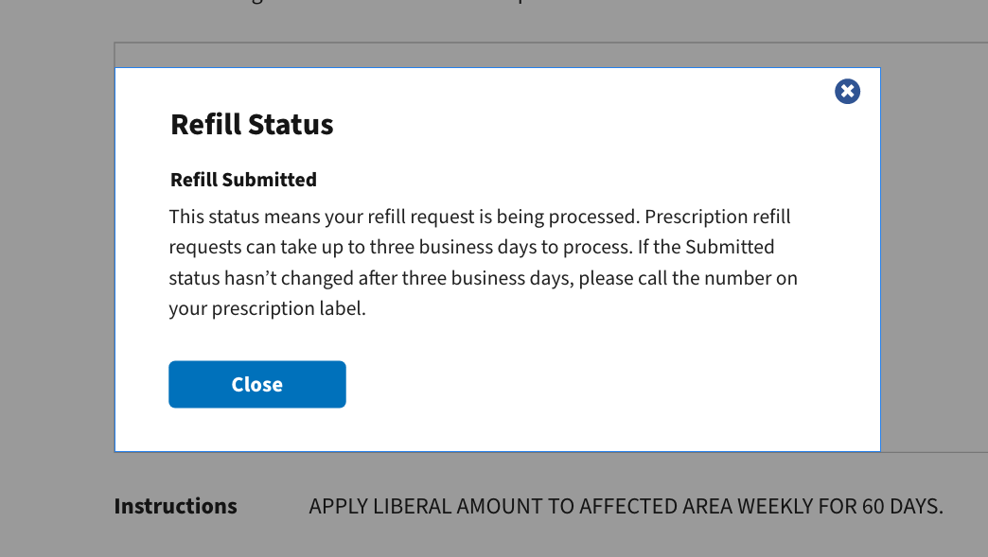
New changes on Medication Details page
Refill Status Changes | December, 2022
Medication page adjustments
Prescription status and Refill status
Refill status tag
Rx status hyperlink
          Rearrange information elements to reflect
Health and Benefits app design

Slide 13
Key findings – Refill VA Prescription page Prototype
Refill Status Changes | December, 2022
Tasks
Refilling a prescription + confirmation
Defining status changes
Finding information on unknown statuses
Exploring the glossary
Interacting with tags
7 referenced the status, 5 knew definition
5 opened the tag pop-up
CBOC coordinators gave positive feedback
“I like how [the tags] tell the Veterans what’s going on so they don’t have to reach out.” – P4
“The color tags look alive!” – P8
Notes:
HOW MANY USED THE CHART TO REFERENCE WHETHER OR NOT A RX WAS REFILLED?

Slide 14
Key findings – Medication Details page
Refill Status Changes | December, 2022
Details Page updates
      3 didn’t know Details page existed
      4 voiced frustration at lack of content on Details page
      6 knew difference between RX and Refill statuses
4 clicked RX status hyperlink
“I expected to see this [Medication Details page], but I was hoping to see more information for side effects and like allergies.” – P2.
“I normally get a new window and look it up on the computer.” – P3.

Slide 15
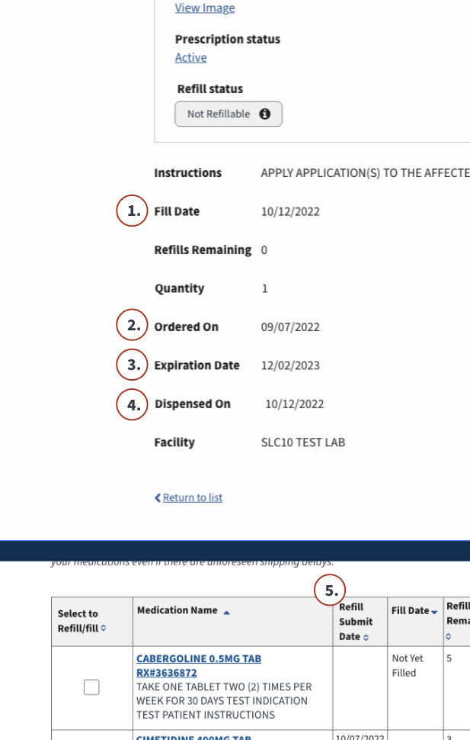
Key findings – Date details
Refill Status Changes | December, 2022
Responses to Dates
7 failed Expiration
3 failed “Ordered on” and “Fill Date”

Slide 16
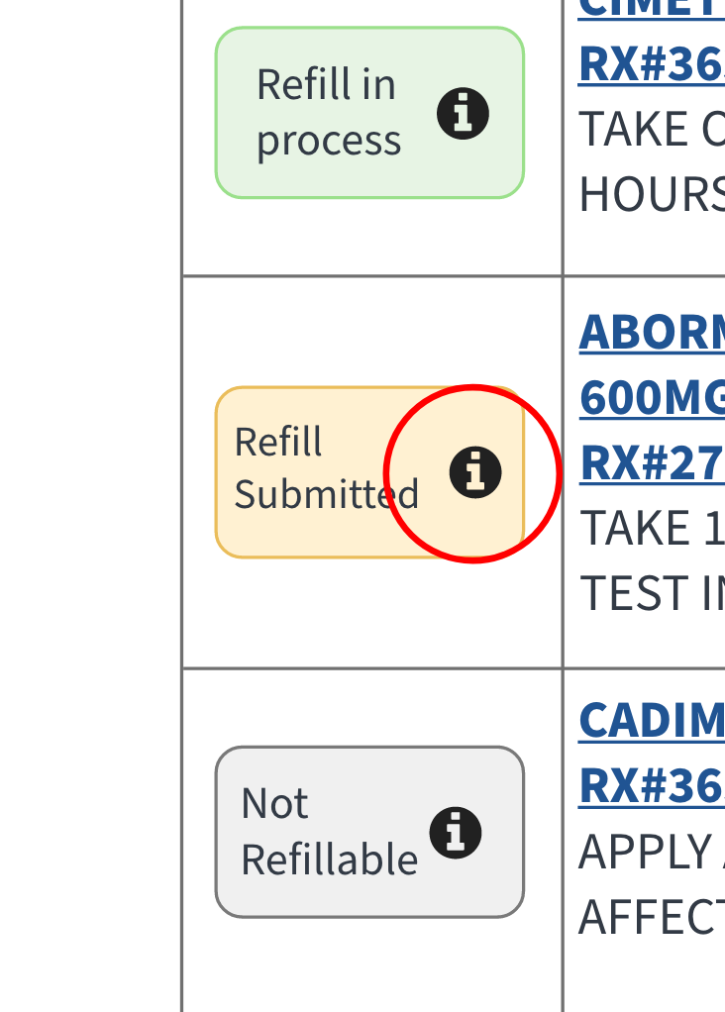
Secondary Findings
Refill Status Changes | December, 2022
Tags
Glossary
3 participants referenced the ‘information’ icon when asked how they knew they could interact with the tags.
Most participants needed assistance finding definitions in the glossary; 2 attempted to leave page altogether.
When asked about being unable to find a definition in the glossary -
“I wouldn't know what to do. I'd reach out to [my healthcare] team and ask.” – P9.

Slide 17
Recommendations
Refill Status Changes | December, 2022
Refill Prescriptions page
Implement tags, pop-ups in Refill VA Prescriptions page.
Rearrange chart for better IA – see mock.
Medication Details page
Revisit Medication Details page layout (contextualize with upcoming research in Sprint 98(?)).
Split Rx and Refill statuses, but test further for better clarity.
Dates
Adjust date names and locations for better clarity or provide Veterans easy access to learn, like a hover state or toggle.

